Slide 1

SYNOPSIS REPORT ON HOSPITAL MANAGEMENT SYSTEM
BY
SAKSHI GOYAL(2200290140132)
SAURABH GUPTA(2200290140137)
Session:2023-2024(iii semester)
Under the supervision of professor
Mr. Prashant agarwal

Slide 2
ABSTRACT
Our project Hospital Management system includes registration of patients, storing their details into the system, and also computerized billing in the pharmacy, and labs. Our software has the facility to give a unique id for every patient and stores the details of every patient and the staff automatically . User can search availability of a doctor and the details of a patient using the id . The Hospital Management System can be entered using a username and password .
The data can be retrieved easily. THE data are well protected for personal use and makes the data processing very fast .

Slide 3
TABLE OF CONTENTS
Introduction
Literature Review
Project / Research Objective
Project Flow/ Research Methodology
Project / Research Outcome
Proposed Time Duration
7. References/ Bibliography

Slide 4
INTRODUCTION
A HOSPITAL MANAGEMENT SYSTEM is a computerized management system. This management system has been developed to form whole management system including Doctors (consultants) , Patients , and Complains etc. This system also keeps the records of hardware assets besides software of this organization. The proposed system will keep a track of Doctors , Patients , and generation of report regarding the present status. This project has GUI based software that will help in storing , updating and retrieving the information through various user-friendly menu-driven modules.

Slide 5
With the advent of 21st century, Health care has become an Industry having tremendous potential . This century witnessed a giant leap in information technology . Computers are not only used to diagnose the illness or for doing surgery with one hundred percent accuracy , but also they are used to increase the efficiency in all fields ranging from fixing the appointment with the Doctor to keeping the record of the Patient . Software application can provide solution and services for the global health care Industry . By using the cutting edge technologies , Hospital Management can be improved with efficient work flow and communication .
Any time any where facilities of the INTERNET have helped the Medical fields to integrate into a single unit . Various Hospitals across the globe can be connected together . They can share information and even services . Details of the Patients , their previous visits etc. are totally not perceptible without a computer . Relevant Informations are always stored in the computer and are available instantly in front of the user .

Slide 6
LITERATURE REVIEW
WHAT IS .NET FRAMEWORK ?
.NET Framework is a software development framework for building and running applications on Windows.
.NET Framework is part of the .NET platform, a collection of technologies for building apps for Linux, macOS, Windows, iOS, Android, and more.
.NET Framework is the original implementation of .NET. It supports running websites, services, desktop apps, and more on Windows.
The .NET Framework also provides a number of features that help improve the security, reliability, and performance of applications

Slide 7
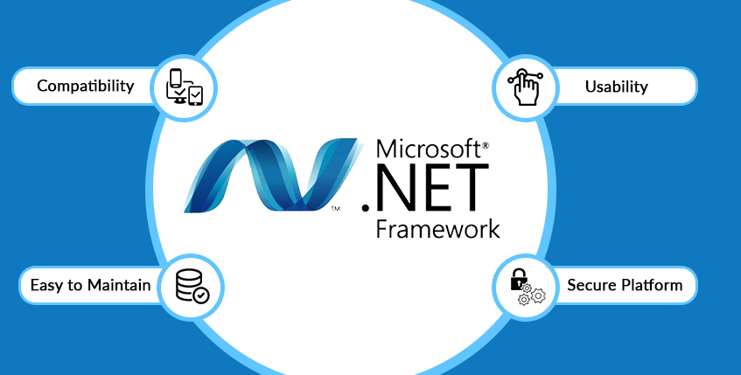

Slide 8
Objective
Hospital information systems provide a common source of information about a patient’s health history , and doctors schedule timing . The system has to keep data in a secure place and controls who can reach the data in certain circumstances.

Slide 9
Problem Domain
This project is aimed to automate the Hospital management system.
This project is developed mainly to administrate doctor’s appointment with the patients . The purpose of the project entitled as HOSPITAL MANAGEMENT SYSTEM is to computerize the front Office Management of hospital to develop software which is user friendly , simple ,fast .
It deals with the collection of Patient’s Information , diagnosis details etc.
The main function is to register and store patient details and doctor details and retrieve these details as and when required.

Slide 10
OUTCOME
Appointment booking
It Helps patients cut the long queue and saves their time.
• Data accuracy
It Removes human errors o Alerts when there’s a shortage of stock.
• Data security
It Helps to keep patients records private .

Slide 11
Conclusion
This can be a powerful tool to help healthcare organizations improve their processes .
It can provide an integrated , comprehensive solution to managing patient records.

Slide 12
REFERENCES
WWW.SLIDESHARE.NET
www.existek.com
WWW.ACADEMIA.EDU

